Slide 1
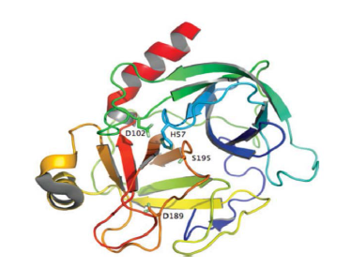
Enzymatic Processes in Industries and its Applications
Protease
By: Neeti Singh
Div: D
Roll no.: 33
Notes:
Line spacing + Page numbers

Slide 2
Index
01 Introduction
02 Role of the enzyme
03 Process
04 Industrial Product: Detergent
05 Industrial Applications
06 How do engineers help in the process?

Slide 3
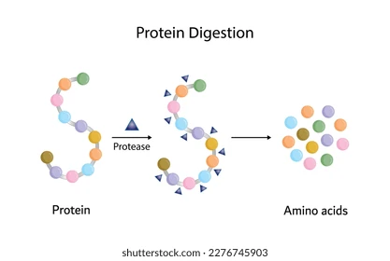
Introduction
01
Protease is an enzyme that catalyses the hydrolysis of peptide bonds present in proteins. Proteases work by cleaving protein chains into smaller pieces called polypeptides or even individual amino acids. They accomplish this through a reaction called hydrolysis, where a water molecule breaks the peptide bond, a fundamental chemical link in proteins. Protease is added to laundry detergents to remove protein-based stains such as food residues(milk), blood or sweat.
Sources:
Mainly in the human body, these enzymes are produced in the stomach and the pancreas.
Microorganisms like Bacillus bacteria and Aspergillus fungi are the preferred source for industrial applications.

Slide 4
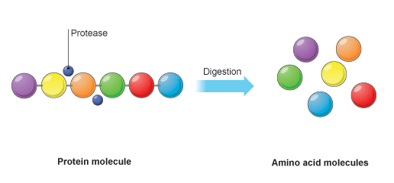
Role of the enzyme
02
Many common stains are made of protein. Water and soap alone cannot easily break them.
Protease cleaves the peptide bonds in proteins. This breaks the large, insoluble protein molecules into smaller, soluble peptides and amino acids. These fragments are then easily rinsed away during washing. Protease secures the removal of proteinaceous food films, which are a particular problem with glassware and cutlery.

Slide 5
Process
03

Slide 6
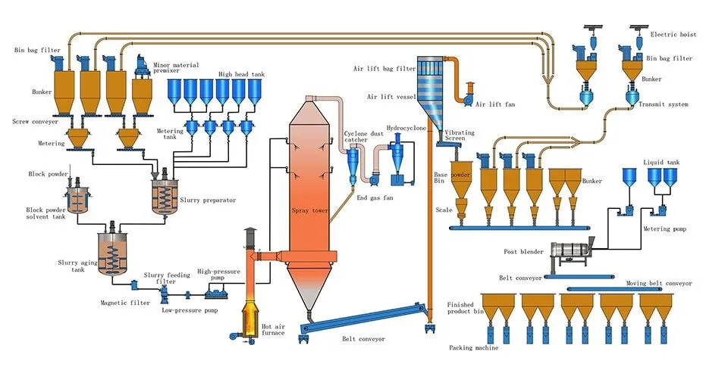
The process for making detergent powder typically involves several steps, with enzyme addition occurring later:
Base formulation: The initial components of the detergent, such as surfactants, builders, and bleaching agents are mixed.
Spray Drying: A slurry of the base mixture is spray-dried in the tower to form a powder.
Post –Tower Processing: The powdered base is then sent to a post-tower processing plant where it is further refined and mixed.
Additives: During this stage, additives that cannot withstand the high temperatures of spray drying, including enzymes(like protease), fragrances, are incorporated int to powder.
Blending: the base powder and the added ingredients are blended to created the final product.

Slide 7
Process Conditions
Protease used in detergents are usually microbially derived, often from Bacillus species.
Formulation Process:
Dry Detergents: Temperature- Ambient (<40°C) to avoid enzyme denaturation. Incorporation of protease- Typically added as a granule or as a coated particle.
Liquid Detergents: Temperature- Typically kept at 25- 40°C. pH- Buffered at pH 7.0-9.0 to ensure enzyme stability. Incorporation of protease- Added at last to avoid shear inactivation. Requires preservatives such as isothiazolinones to prevent microbial growth.
In general:
Avoid exposures to high temperatures (>50 °C).
Avoid dust formations in dry formulation because enzyme dust is hazardous.

Slide 8

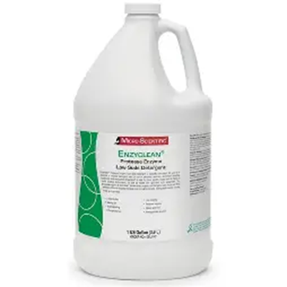
Industrial Product: Detergent
04
Detergency is a term which describes the process of cleaning by a surface active agents. Detergents play important role in life. Surfactants, builders, corrosion inhibitors, brighteners, bleaching agents and enzymes are ingredients of detergents. Enzymes are the key components in formulation of detergents such as protease. The essential ingredient in modern detergents is protease enzyme. Detergents containing enzymes are effective in removing strains and reduce water consumptions.
Detergent contains a mixture of enzymes, including: Protease (for protein stains) Amylase (for starch stains) Lipase (for grease/oil stains) Cellulase (for fabric care)
Product forms:
Powder detergents Liquid detergents
Benefits: Works effectively at low temperatures. Reduces the need for hot water(energy saving). Eco friendly asfewer harsh chemicals needed.
Improved cleaning performance across a range of stains.

Slide 9
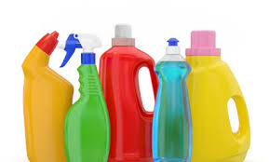
Industrial Applications
05
Household Cleaning: Used in home laundry detergents for stain removal.
Commercial Laundry: Hospitals, hotels, restaurants for removing touch organic stains.
Textile industry: Used to clean raw fabric and remove protein residues.
Environmental: Helps reduce chemical waste and water pollution from traditional detergents.

Slide 10
How do engineers help in the process?
06
Computer engineers play a critical role in the development of detergents made with protease enzymes. Essentially, the proteases used in detergents are engineered for better stability in heat, pH and surfactants. Computer engineers develop the software tools that model protein structure predictions and enzyme-substrate interactions, all of which is an integral part of the process of the formulation of detergents. The tools need efficient algorithms and coding which are provided by computer engineers. Hence, in this manner computer engineers help in the process of manufacture of detergents.

Slide 11
References
Pictures:
5+ Hundred Protease Enzyme Structure Royalty-Free Images, Stock Photos & Pictures | Shutterstock
Endopeptidases Proteases Enzymes in Proteins
https://micro-scientific.com/media/catalog/product/cache/7334c43de45d02dba8238855f70ce207/e/b/ebl1hc.png
Protease Laundry Detergent Enzyme - BBT-CHINA
Content:
Purification and characterization of detergent-compatible protease from Aspergillus terreus gr – PubMed
Powder Detergent: Ingredients & Manufacturing Process Explained
Protease - Wikipedia

Slide 12
Thank You!

